Slide 1

Experiencing M I S
Ninth Edition
Chapter Extension 7
Using Microsoft Access 2019
Slides in this presentation contain hyperlinks. JAWS users should be able to get a list of links by using INSERT+F7
Copyright © 2021, 2019, 2017 Pearson Education, Inc. All Rights Reserved
Notes:
If this PowerPoint presentation contains mathematical equations, you may need to check that your computer has the following installed:
1) MathType Plugin
2) Math Player (free versions available)
3) NVDA Reader (free versions available)
In this chapter extension, you will learn fundamental techniques for creating a database and forms, queries, and reports with Microsoft Access.

Slide 2
Study Questions
CE 7-1 How do you create tables?
CE 7-2 How do you create relationships?
CE 7-3 How do you create a data entry form?
CE 7-4 How do you create queries using the query design tool?
CE 7-5 How do you create a report?
Notes:
This chapter extension discusses fundamental techniques for creating a database and a database application with Microsoft Access 2019.

Slide 3
Creating Tables
CE 7-1 How do you create tables?
Create two tables from data model
PROSPECT (Prospect I D, Name, Street, City, State, Zip, Email Address)
WORK (Prospect I D, WorkDate, Hour, NumCalls, TotalDonations)
Link tables
Select primary keys
Select foreign keys
Notes:
Note the ambiguity in name PROSPECT. Before someone has become a volunteer, he is a prospect, and the term is fine. However, once that person has actually done work, he is no longer merely a prospect. This ambiguity occurs because the database is used both for finding volunteers and for recording their experiences once they have joined.

Slide 4
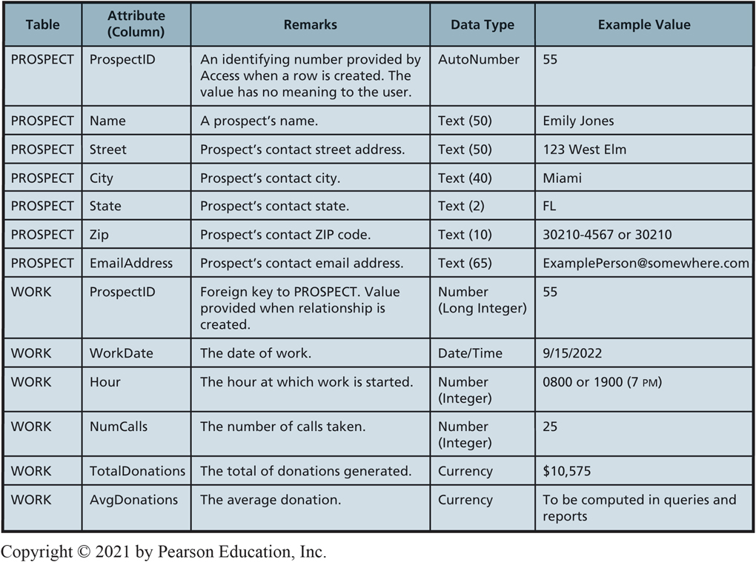
Attributes of the Database
CE 7-1 How do you create tables?
Figure C E 7-1 Attributes of the Database
Notes:
This figure further documents the attributes of the design. Sample data for this table are shown in Figure CE7-2, pg. 435.

Slide 5
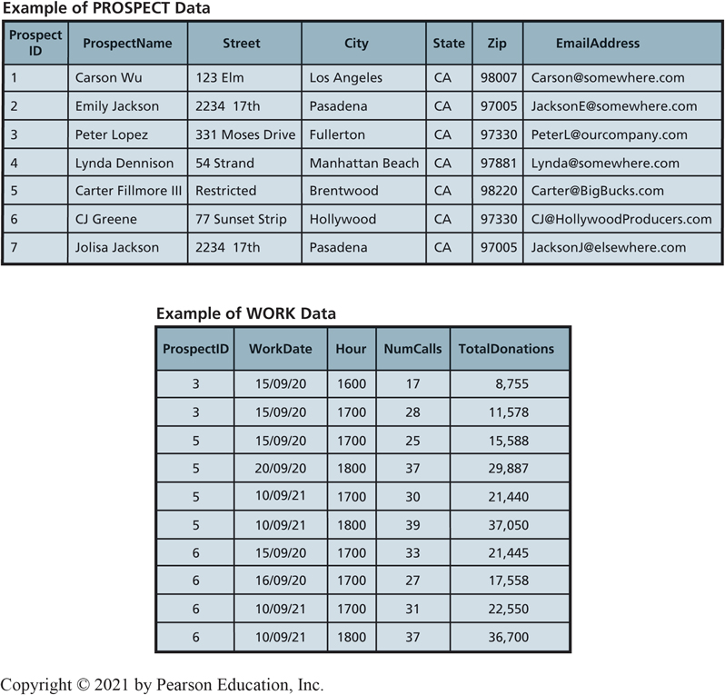
Sample Data (PROSPECT and WORK)
CE 7-1 How do you create tables?
Figure C E 7-2 Sample Data

Slide 6
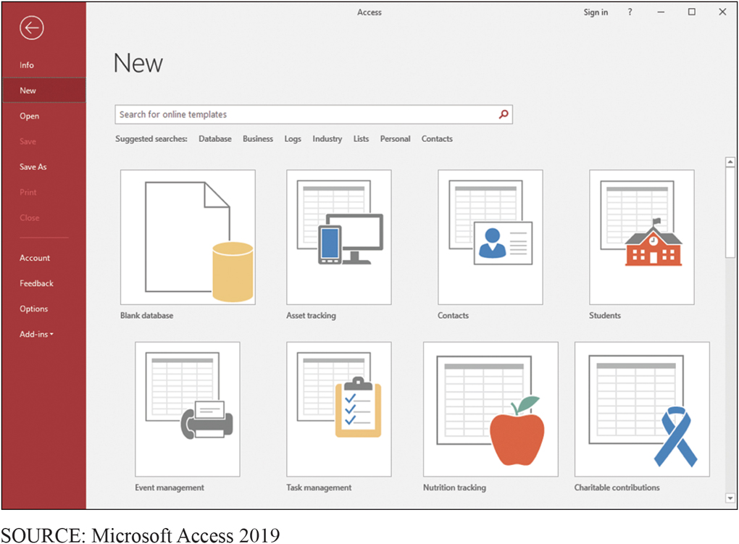
Opening Screen for Access 2019
CE 7-1 How do you create tables?
Figure C E 7-3 Opening Screen for Microsoft Access 2019
Notes:
If you use another version of Access, your screen will appear differently, but the essentials will be the same.

Slide 7
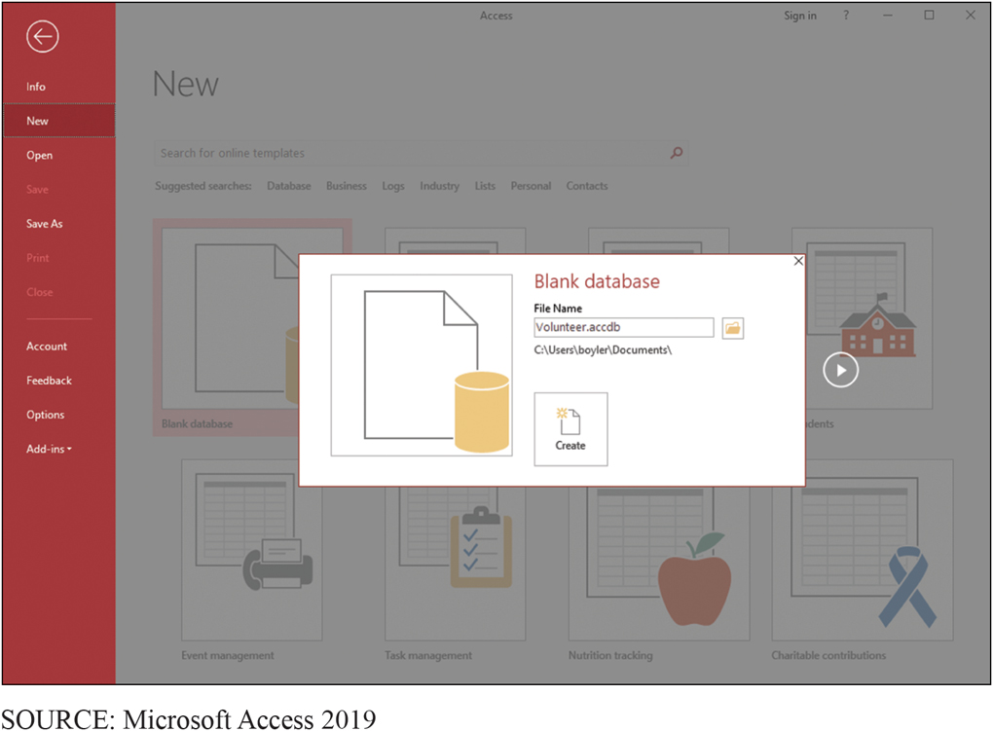
Naming a Desktop Database
CE 7-1 How do you create tables?
Figure C E 7-4 Naming a Desktop Database

Slide 8
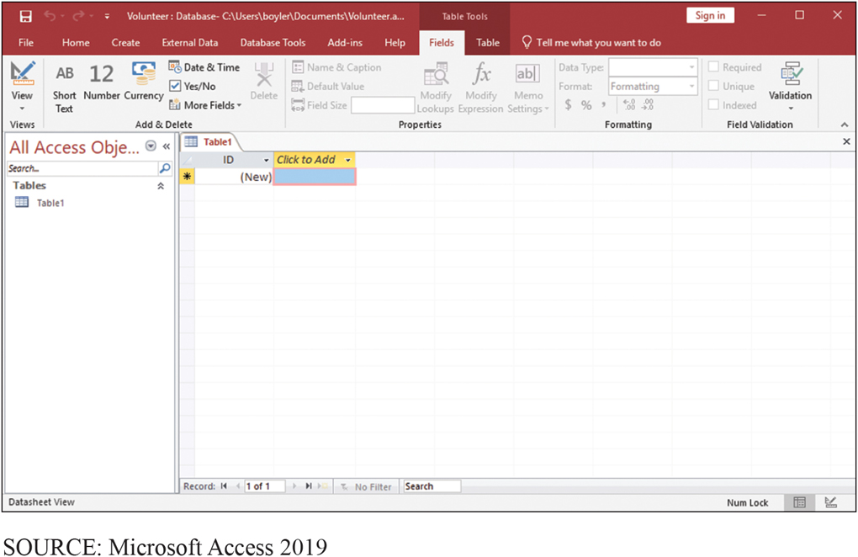
Initial Table Definition
CE 7-1 How do you create tables?
Figure C E 7-5 Access Opens with an Initial Table Definition

Slide 9
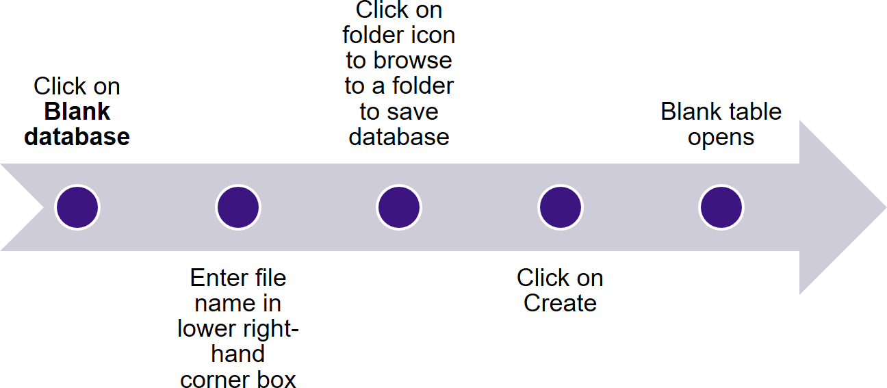
Review: Sequence of Steps for Creating a Database with Access
CE 7-1 How do you create tables?
Notes:
Use this figure to review the steps presented in previous slides.

Slide 10
Creating Tables (Step 1) (1 of 2)
CE 7-1 How do you create tables?
Click View icon
Select Design View in drop-down list
Enter table name in pop-up box
Window changes to Design View

Slide 11
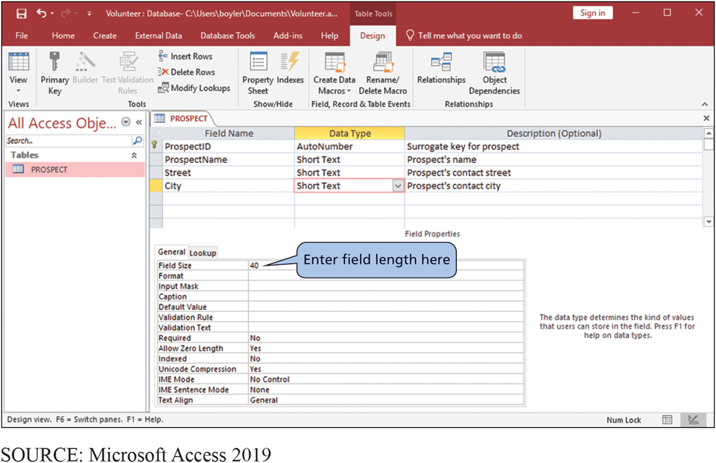
Creating Tables (Step 1) (2 of 2)
CE 7-1 How do you create tables?
Upper part
Enter name of each attribute (Fields)
Enter Data Type
Enter Description
Bottom part
Declare field properties
Figure C E 7-6 Creating Tables in Access, Step 1
Notes:
Explain Access menu bar.

Slide 12
Setting the Length of a Text Data Type
CE 7-1 How do you create tables?
Figure C E 7-7 Creating Tables in Access, Step 2
Notes:
Figure shows how to set the length of a Text Data Type.

Slide 13
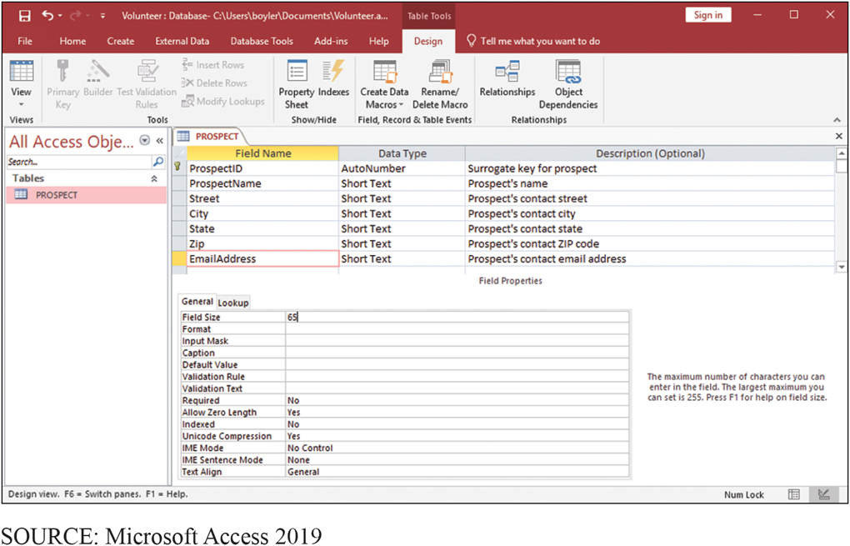
Finished Sample PROSPECT Table
CE 7-1 How do you create tables?
Figure C E 7-8 Complete Sample PROSPECT Table
Notes:
ProspectID is the primary key of this table, and the little key icon next to the ProspectID Field Name means Access has already made it so. If we wanted to make another field the primary key, we would highlight that field and then click the Primary Key icon in the left-hand portion of the Design ribbon.

Slide 14
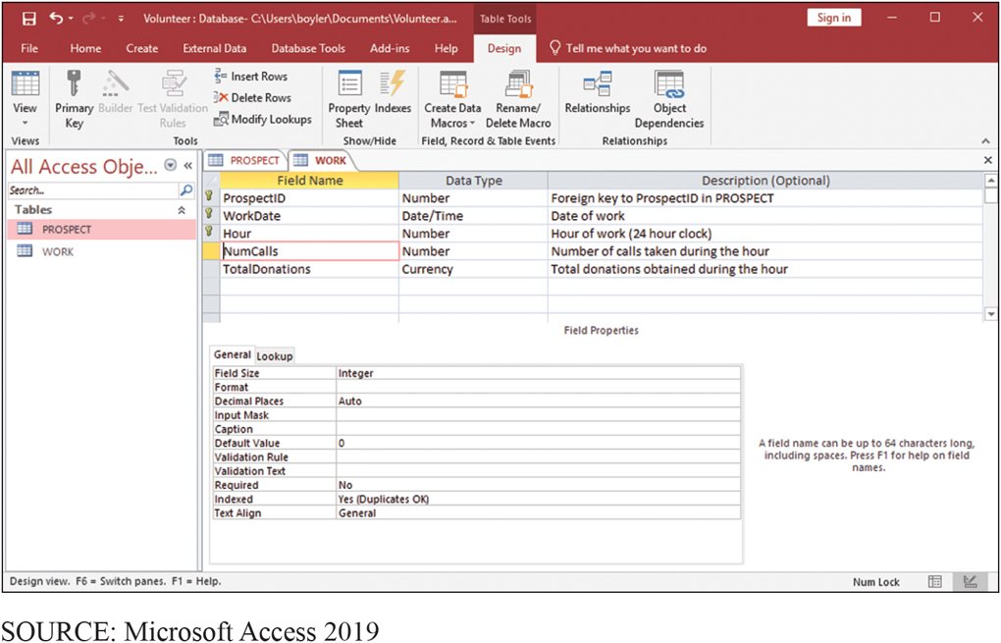
Finished Sample WORK Table
CE 7-1 How do you create tables?
Figure C E 7-9 Finished WORK Table

Slide 15
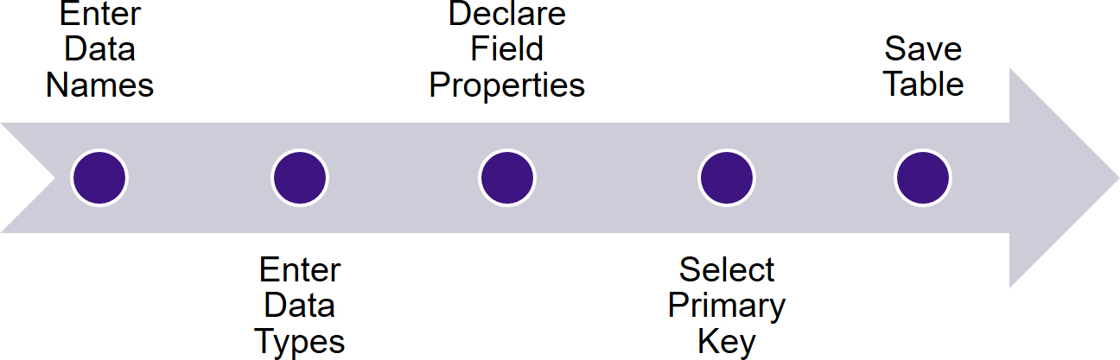
Overview of Steps in Creating Tables
CE 7-1 How do you create tables?

Slide 16
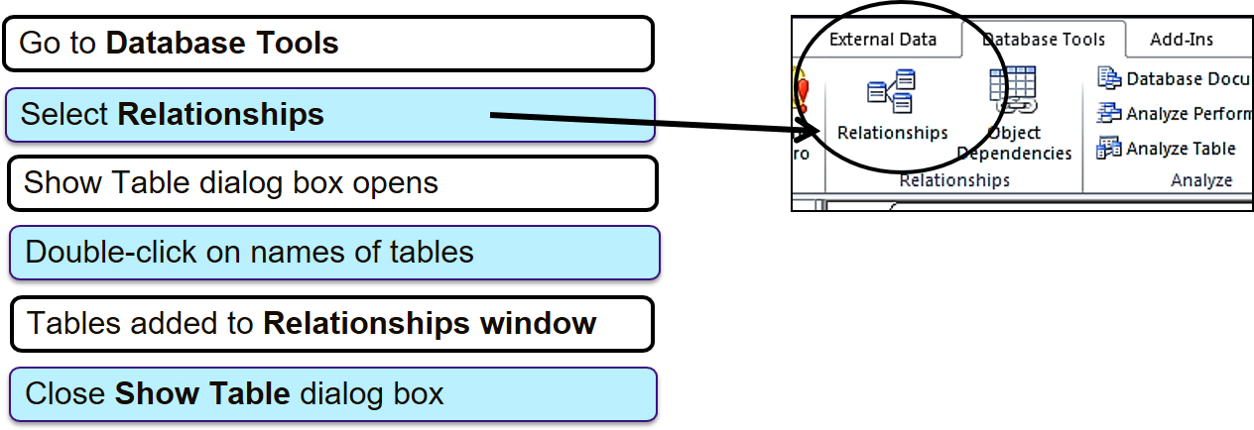
Creating Relationships
CE 7-2 How do you create relationships?

Slide 17
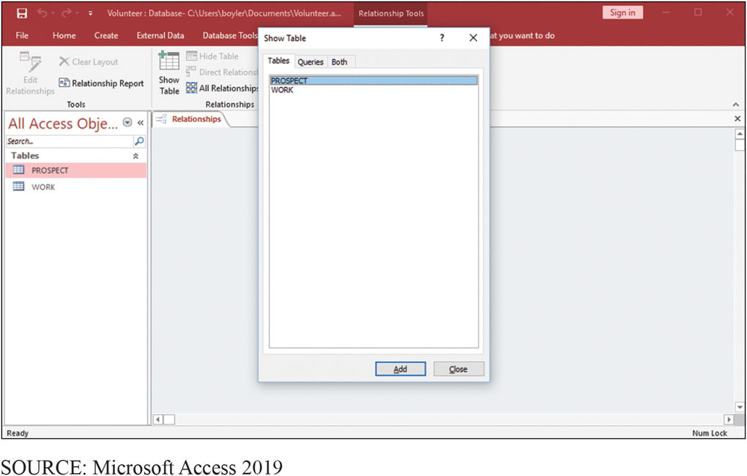
Table Dialog Box
CE 7-2 How do you create relationships?
Figure C E 7-10 The Show Table Dialog Box in Access
Notes:
Click the Database Tools tab in the ribbon and then click the Relationships icon near the left-hand side of that ribbon. The Relationships window will open and the Show Table dialog box will be displayed.

Slide 18
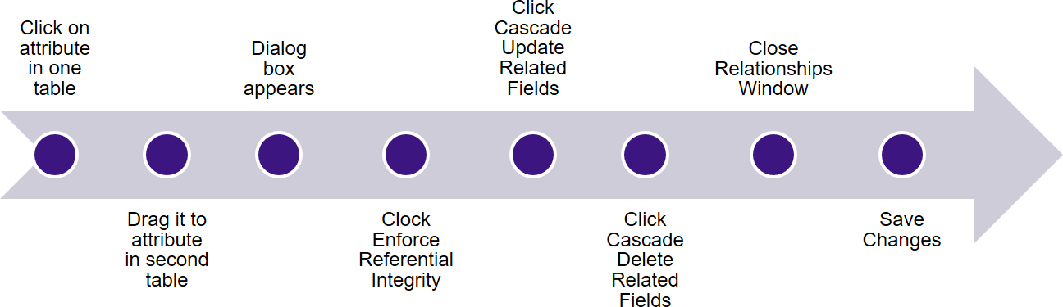
Creating a Relationship Between Two Tables (Step 2)
CE 7-2 How do you create relationships?
Notes:
Use this figure to review the steps presented in previous slides.

Slide 19
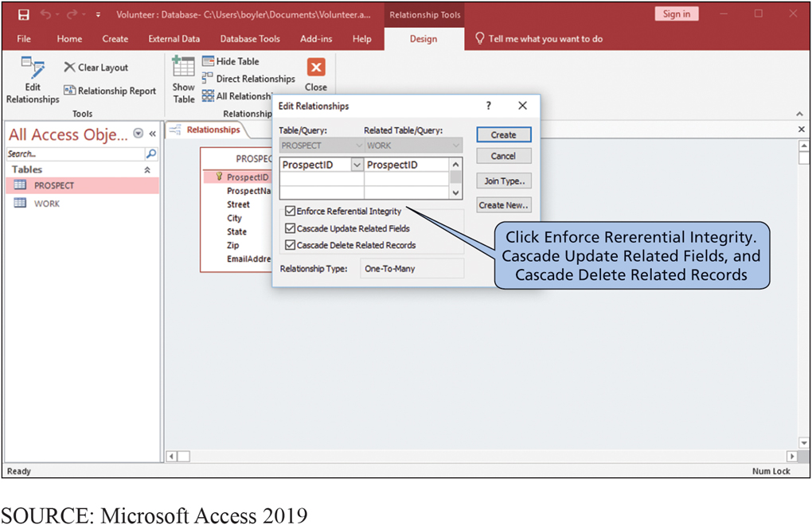
Creating a Relationship Between Two Tables
CE 7-2 How do you create relationships?
Figure C E 7-11 Creating a Relationship Between Two Tables
Notes:
Click Enforce Referential Integrity, click Cascade Update Related Fields, and then click Cascade Delete Related Records. The specifics of these actions are beyond the scope of our discussion. Just understand that clicking these options will cause Access to make sure that ProspectID values in WORK also exist in PROSPECT.

Slide 20
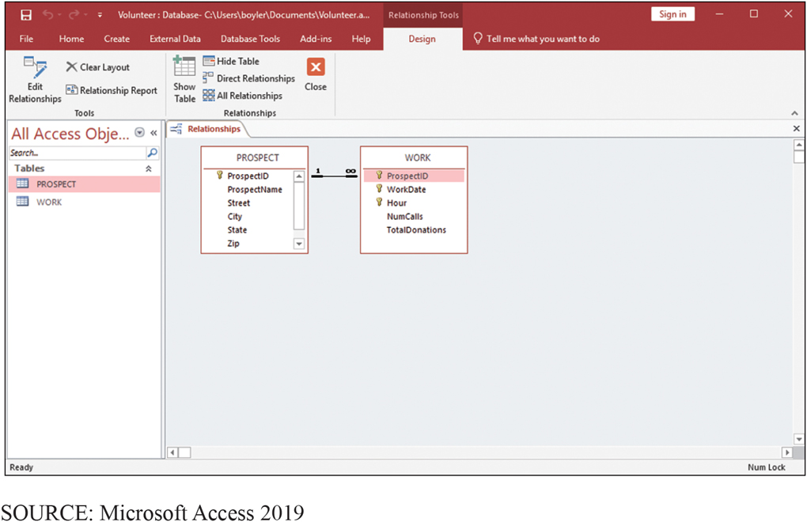
Completed Relationship
CE 7-2 How do you create relationships?
Figure C E 7-12 Completed Relationship Between PROSPECT and WORK Tables

Slide 21
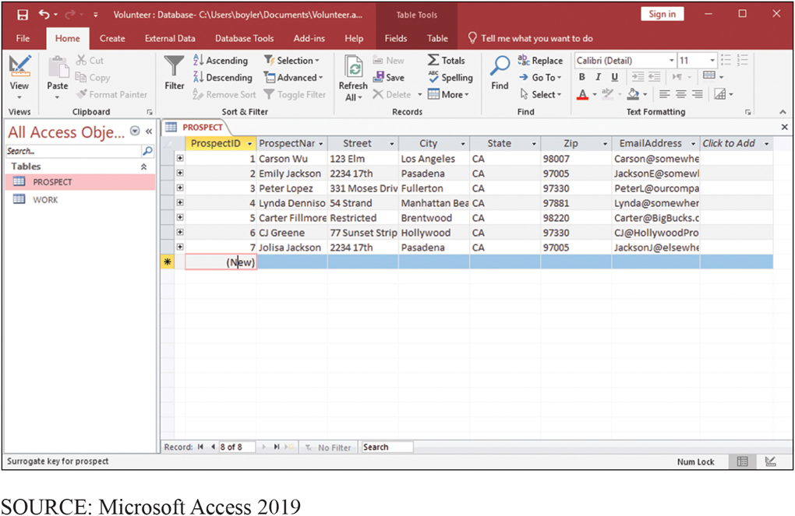
Data Entered in the PROSPECT Table
CE 7-3 How do you create a data entry form?
Figure C E 7-13a Tables with Data Entered for PROSPECT

Slide 22
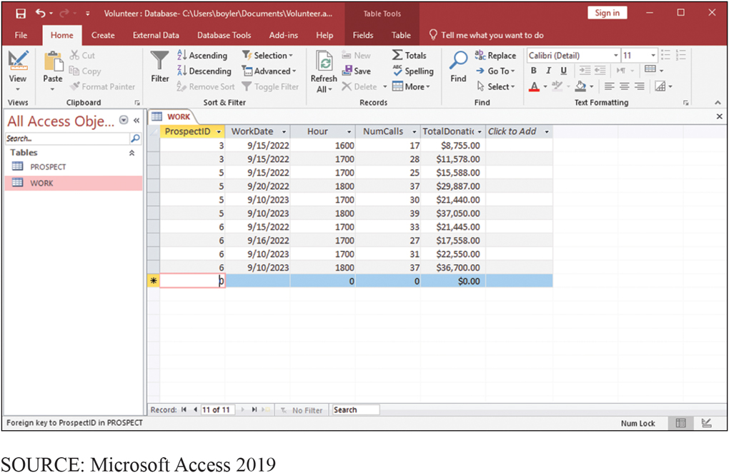
Data Entered in the WORK Table
CE 7-3 How do you create a data entry form?
Figure C E 7-13b Tables with Data Entered for WORK

Slide 23
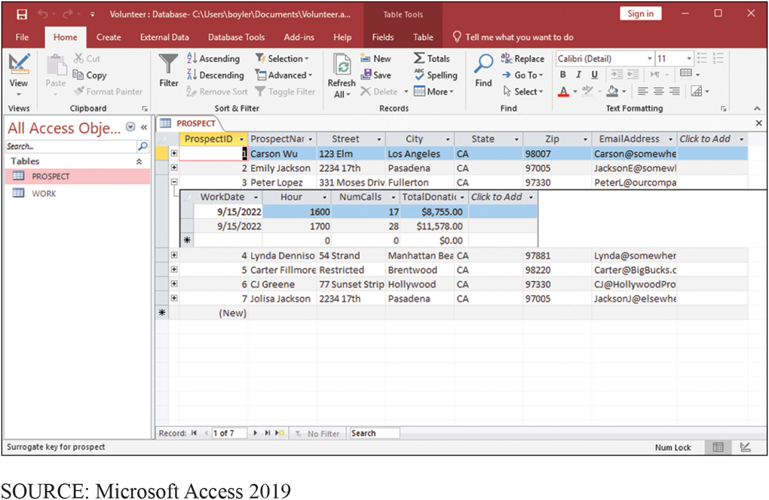
Use Default Table Display
CE 7-3 How do you create a data entry form?
Figure C E 7-14 Default Table Display
Notes:
Default table display, although convenient, is limited in capability. It does not provide a very pleasing user interface. For more generality and better design, you can use the Access form generator.

Slide 24
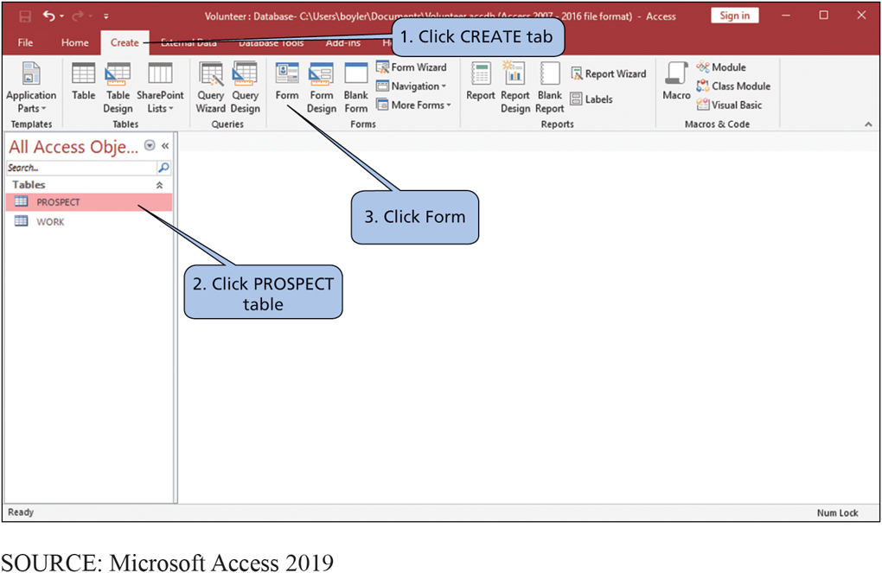
Form Generator
CE 7-3 How do you create a data entry form?
Figure C E 7-15 Starting the Form Generator

Slide 25
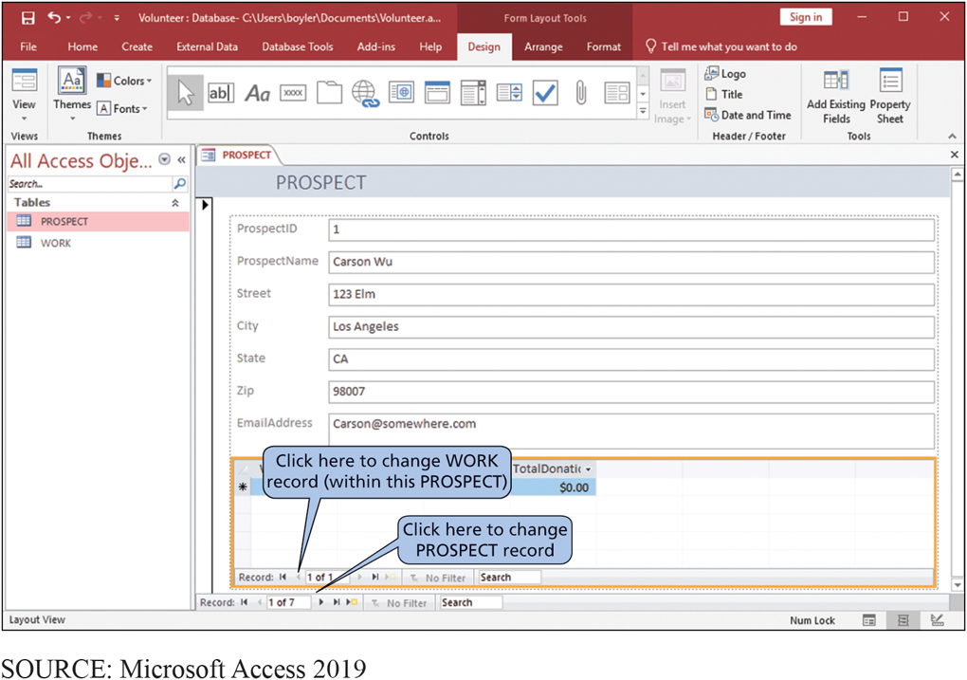
Resulting Data Entry Form
CE 7-3 How do you create a data entry form?
Figure C E 7-16 Resulting Data Entry Form
Notes:
Access uses metadata about tables and their relationship to create the data entry form in Figure CE7-16.

Slide 26
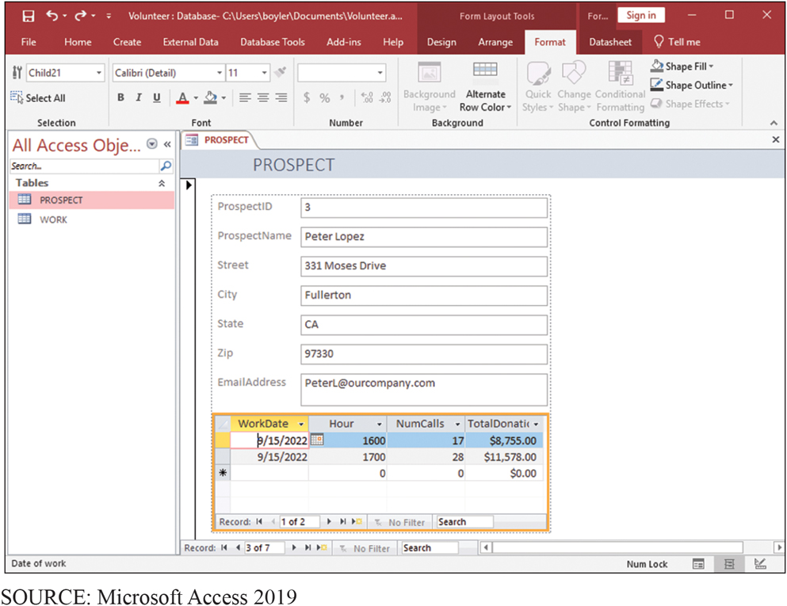
Reformatted Data Entry Form
CE 7-3 How do you create a data entry form?
Figure C E 7-17 Reformatted Data Entry Form

Slide 27
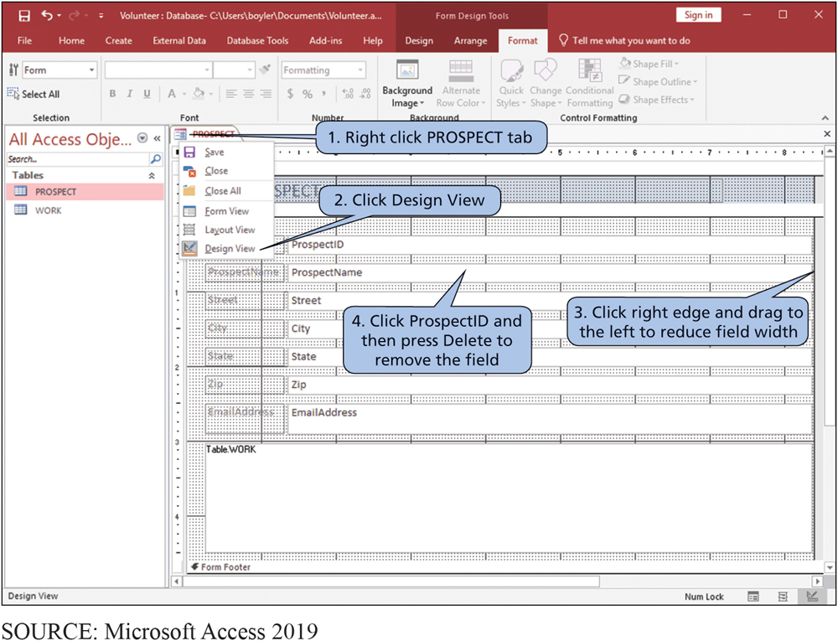
Process for Reformatting Data Entry Form
CE 7-3 How do you create a data entry form?
Figure C E 7-18 Process for Reformatting Data Entry Form

Slide 28
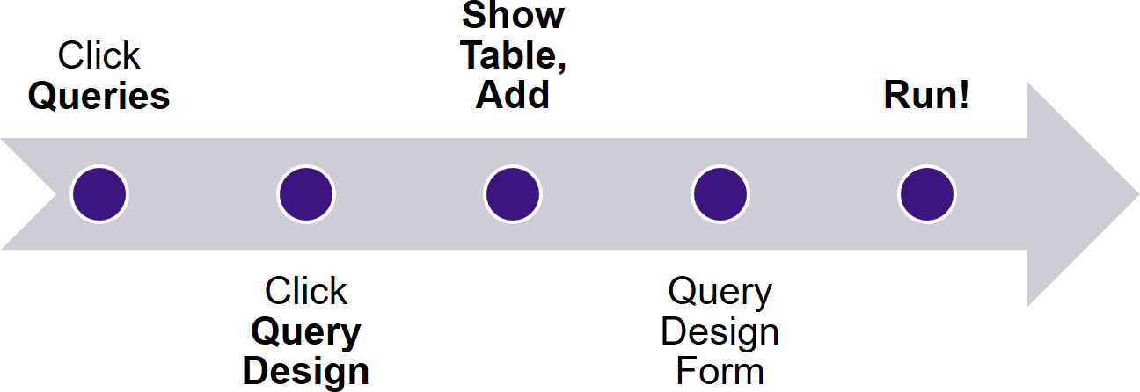
Using the Graphical Interface to Create Queries
CE 7-4 How do you create queries using the query design tool?
Notes:
Use this figure to review the steps presented in previous slides. Like all modern DBMS products, Access can process the SQL query language.

Slide 29
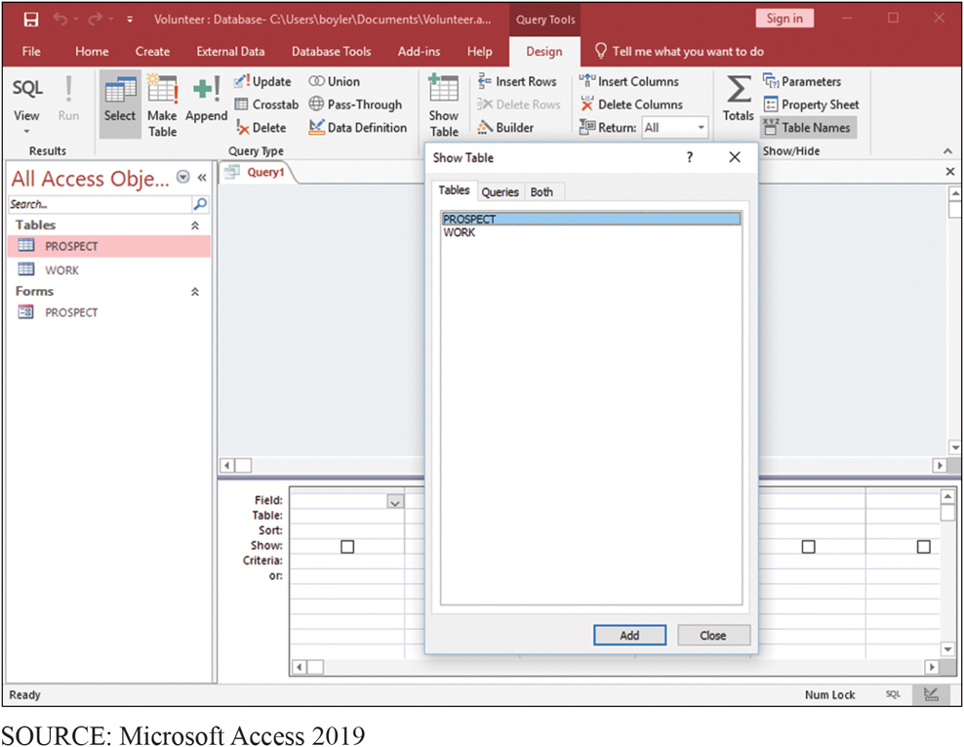
Creating a Query (Step 1)
CE 7-4 How do you create queries using the query design tool?
Figure C E 7-19 Creating a Query, Step 1

Slide 30
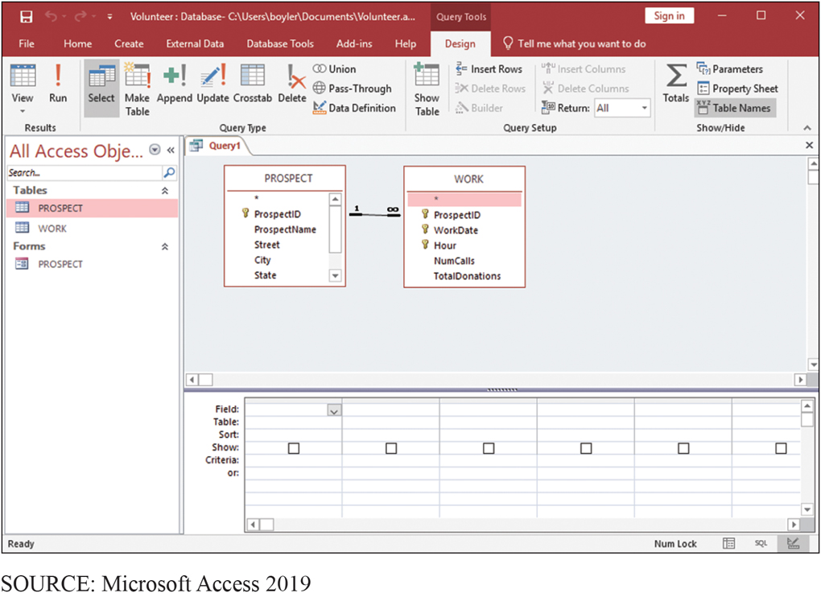
Creating a Query (Step 2)
CE 7-4 How do you create queries using the query design tool?
Figure C E 7-20 Creating a Query, Step 2
Notes:
Notice that Access shows the 1:N relationship between the tables.

Slide 31
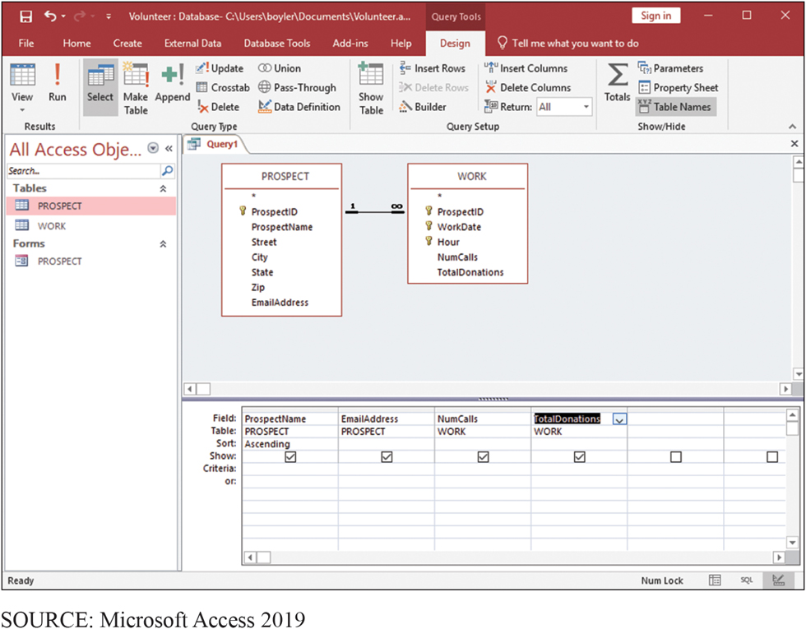
Creating a Query (Step 3)
CE 7-4 How do you create queries using the query design tool?
Figure C E 7-21 Creating a Query, Step 3
Notes:
Note that the Ascending keyword has been selected for the Name column.
Click red exclamation point labeled Run in the Results section of ribbon.

Slide 32
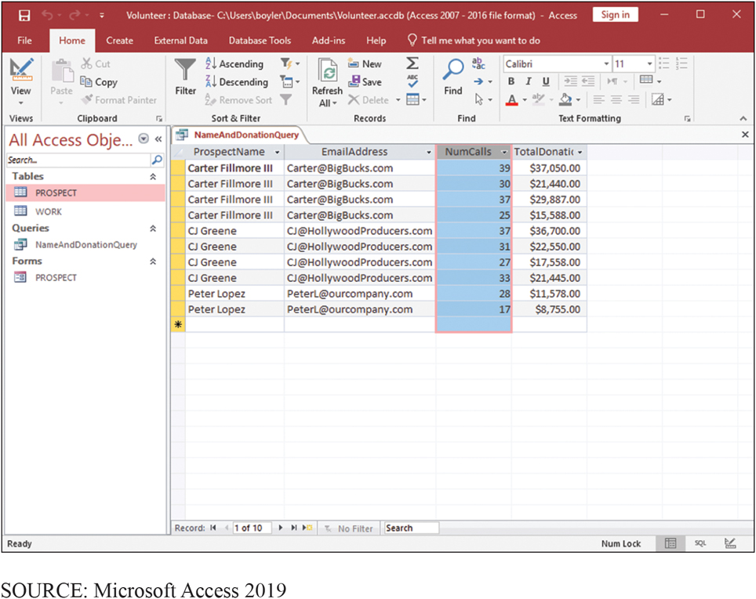
Results of Total Donations Query
CE 7-4 How do you create queries using the query design tool?
Figure C E 7-22 Results of Total Donations Query

Slide 33
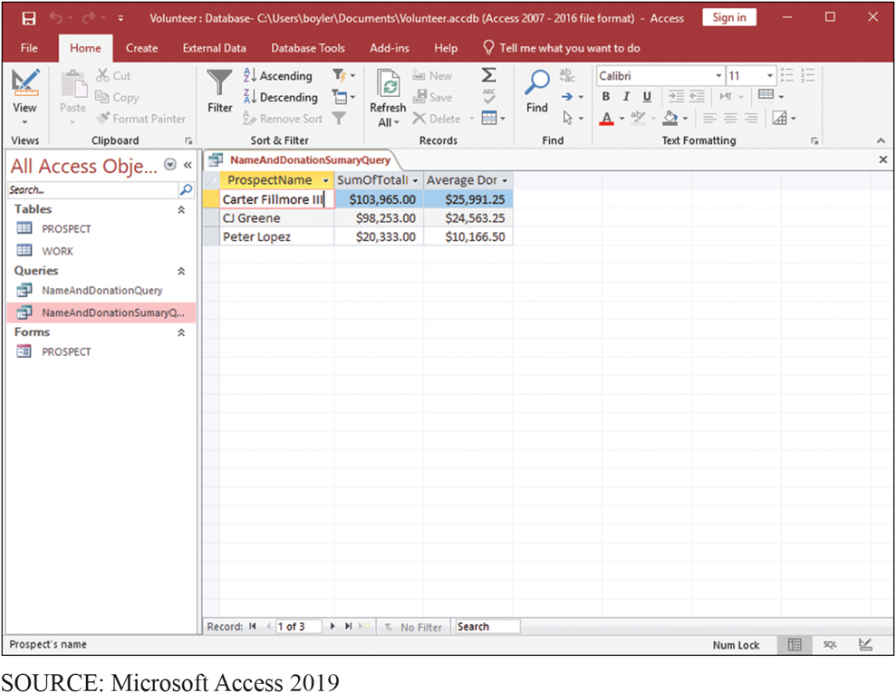
Result of More Advanced Query
CE 7-4 How do you create queries using the query design tool?
Figure C E 7-23 Result of More Advanced Query

Slide 34
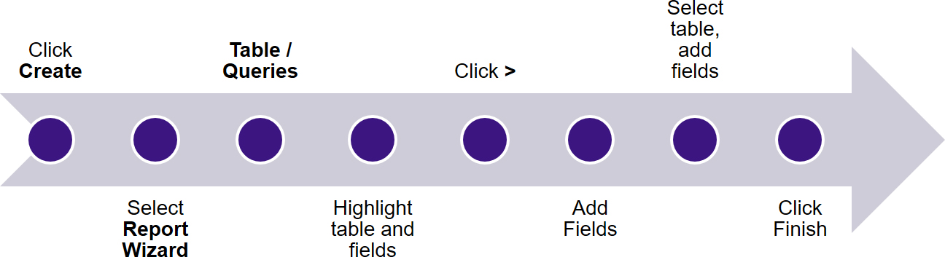
Creating a Report
CE 7-5 How do you create a report?

Slide 35
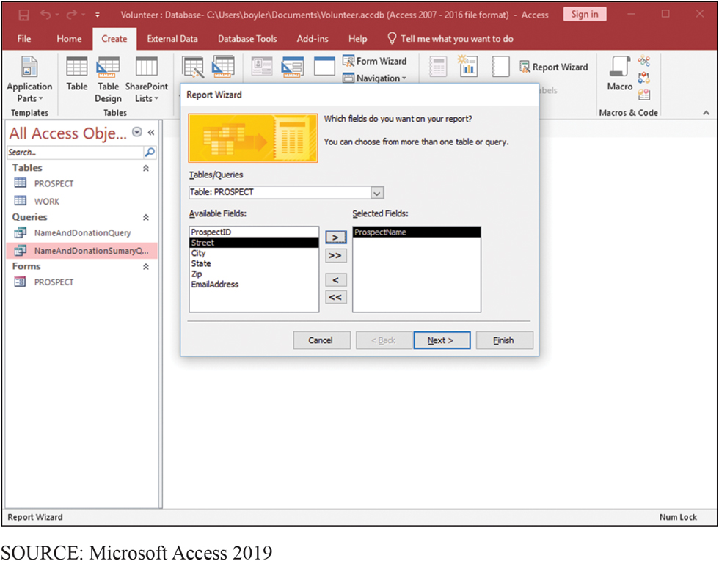
Selecting Data to Show in a Report
CE 7-5 How do you create a report?
Figure C E 7-24 Selecting Data to Show in a Report
Notes:
This figure shows the Report Wizard. To create a report with data from two or more tables, we must use the Report Wizard.
Click the Create tab, and then in the Reports section click Report Wizard.

Slide 36
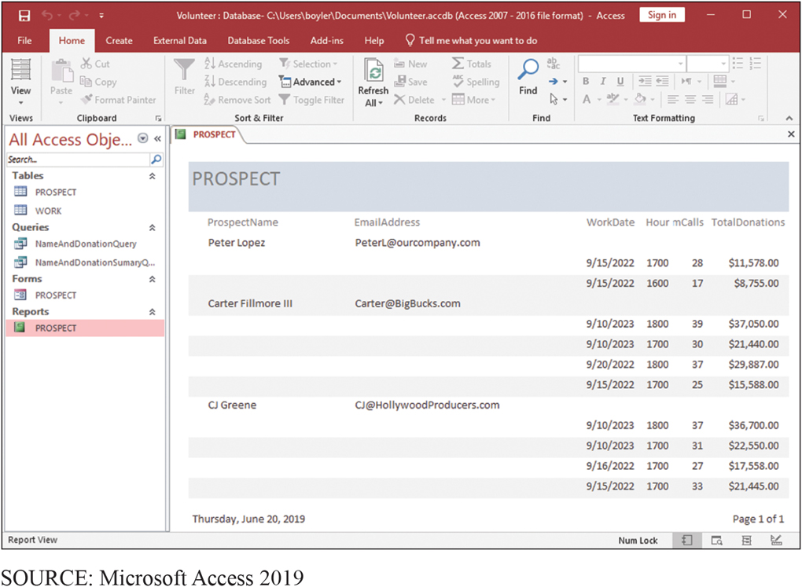
Report on Donations, by Prospect
CE 7-5 How do you create a report?
Figure C E 7-25 Report on Donations, by Prospect

Slide 37
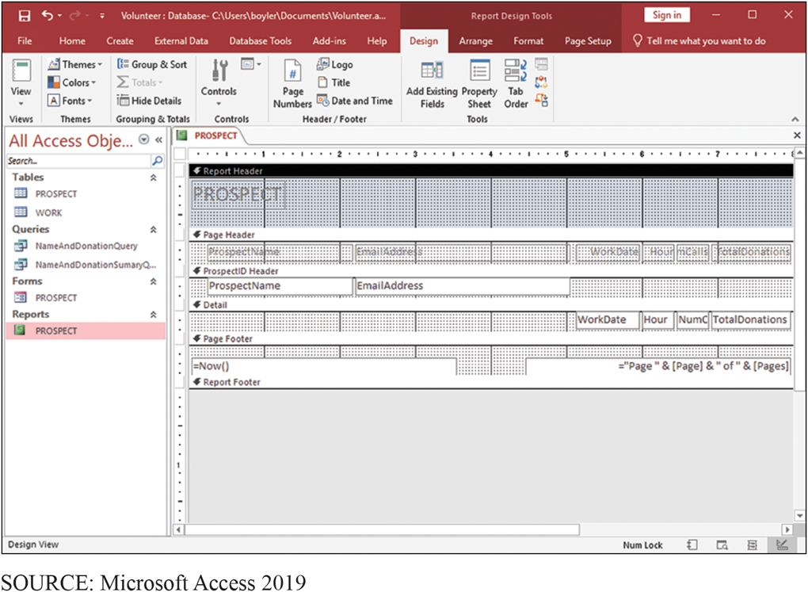
Report Design View (1 of 2)
CE 7-5 How do you create a report?
Figure C E 7-26 Report Design View

Slide 38
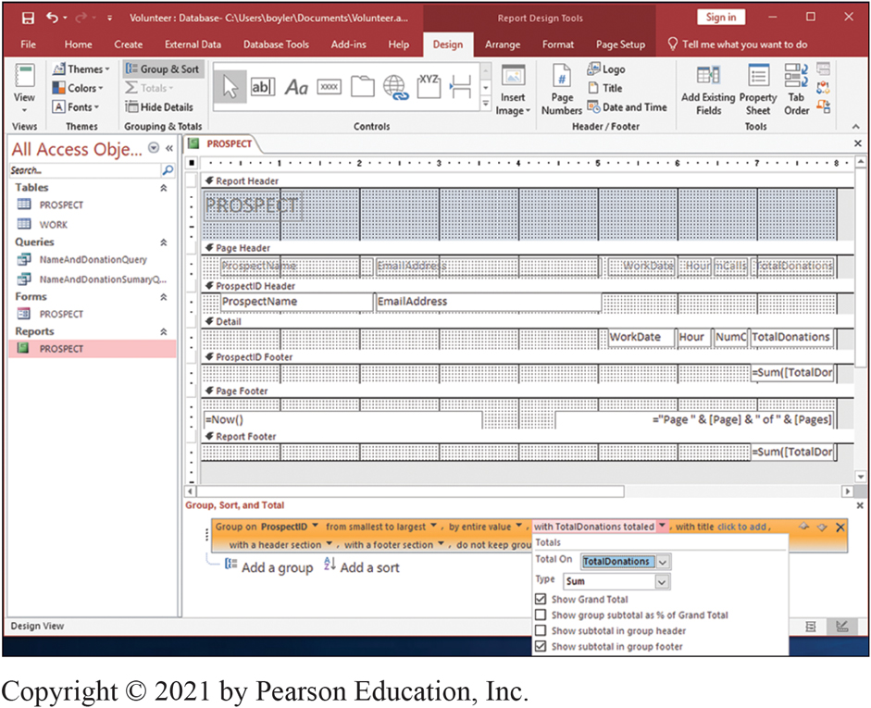
Report Design View (2 of 2)
CE 7-5 How do you create a report?
Figure C E 7-27 Creating a Sum of TotalDonations for Each Prospect
Notes:
In the ribbon, click Group and Sort in the Grouping & Totals section. In the bottom of the form, click More, and then click the down arrow next to the phrase “with no totals.” Next, select TotalDonations from the Total On box, and then check Show Grand Total and Show subtotal in group footer.

Slide 39
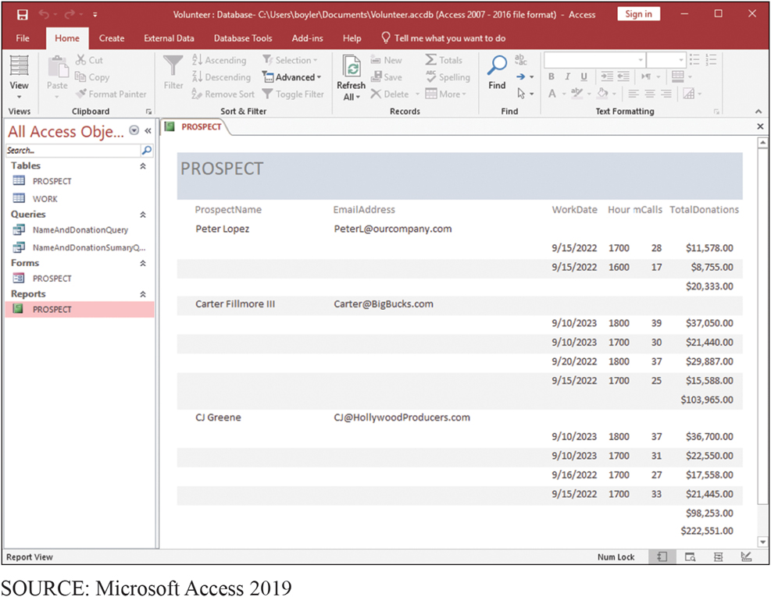
Report with Sum of TotalDonations
CE 7-5 How do you create a report?
Figure C E 7-28 Report with Sum of TotalDonations
Notes:
The only remaining problem is that label NumCalls is cut off. We need to expand the box that contains this value. To do so, select Layout View from View in the ribbon, click WorkDate, and then slide it slightly to the left. Do the same with Hour. Then expand NumCalls until you can see all of the label.

Slide 40
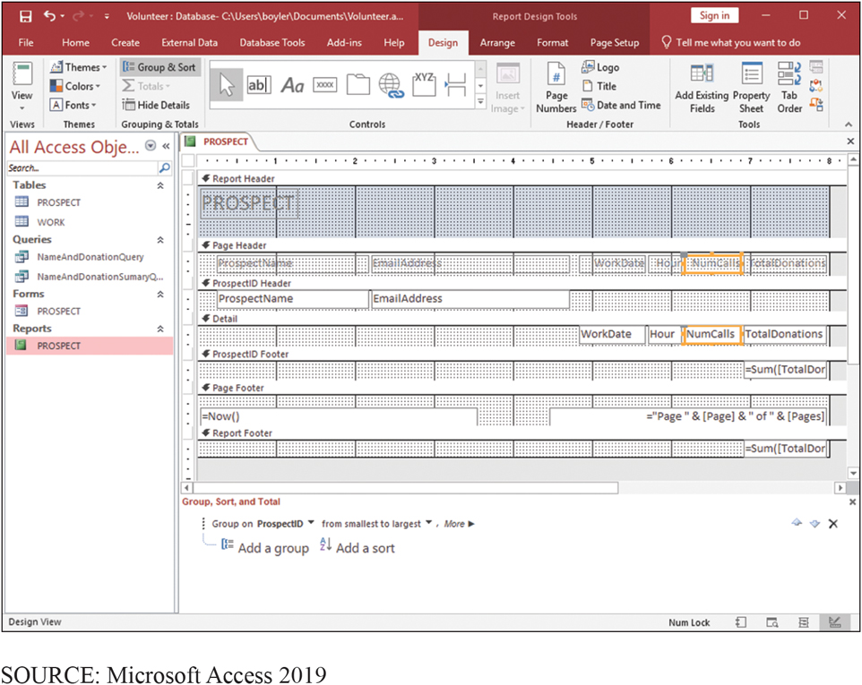
Increasing Size of Fields
CE 7-5 How do you create a report?
Figure C E 7-29 Increasing the Size of the NumCalls Field
Notes:
Select Layout View from View in the ribbon, click WorkDate. Slide it slightly to left. Do same with Hour. Expand NumCalls.

Slide 41
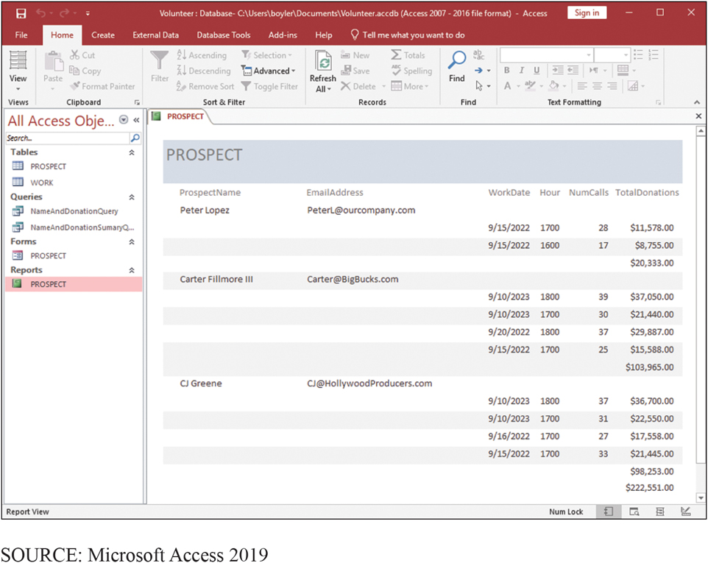
Final Version of Report
CE 7-5 How do you create a report?
Figure C E 7-30 Final Version of Report

Slide 42
Active Review
CE 7-1 How do you create tables?
CE 7-2 How do you create relationships?
CE 7-3 How do you create a data entry form?
CE 7-4 How do you create queries using the query design tool?
CE 7-5 How do you create a report?
Notes:
In this chapter extension, you learned fundamental techniques for creating a database and forms, queries, and reports with Microsoft Access.

Slide 43

Copyright

